Slide 1
Jump Rope City
CS - 370
Kamin Fay | Celine Fucci | Kevin Ho | Ethan McGowan | Jalen Pestillo
Notes:
Jay introduces us

Slide 2
System Intent
To create a game that can be programmed by the user (You) and implemented on a randomly generated or user generated course developed by our team of developers.
Notes:
Kamin goes, Celine next

Slide 3
Cycle Intent
The architectural spike contained features such as a jump rope layout and animations. Essentially:
A map was built containing ropes
Rectangles were used to depict animations and emulate user interaction
The angling system will calculate rope angles
Notes:
Celine Now, Kev next

Slide 4

Features
Jump Rope City Key Features:
Random Generated Maps
User Generated Maps
User input detection
Graphical response detection
Notes:
Kev now, Ethan next

Slide 5
Design
The design of Jump Rope City is a playing field of random generated maps containing ropes. These ropes are randomly generated throughout the map for the player (You) to jump over them.
Notes:
Ethan now, Jay next

Slide 6
Plan
Create a standardized code layout, for easy sharing of code and resources.
Design and implement a graphical map editor.
Timer and scoring system for user generated maps, to allow for “training” and improvement.
Tweak movement options for the play.
Implement angling system for ropes and players.
Notes:
Jay now, Kev next

Slide 7
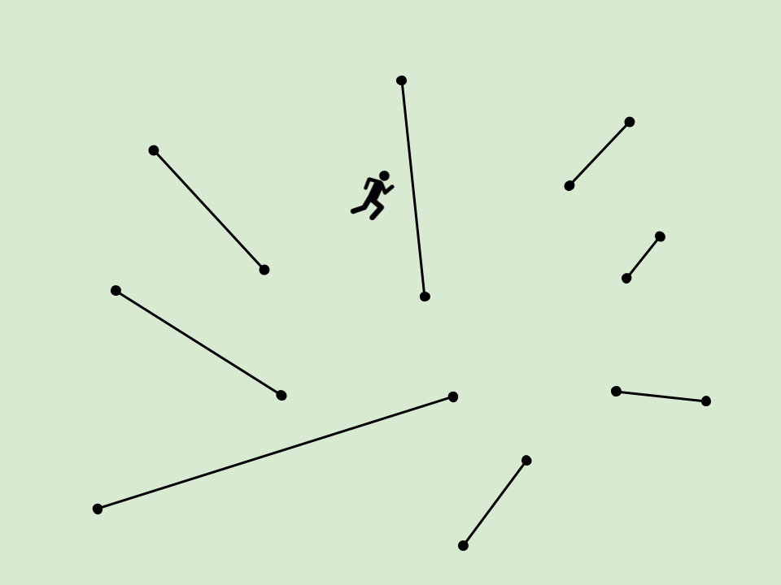
Notes:
Going into demos, Kev is up first

Slide 8



Process/Tools/Standards
SDL2-2.0.5
SDL2_image-2.0.1
SDL2_mixer-2.0.1
Slack
GitHub
Notes:
Going into demos, Kev is up first

Slide 9
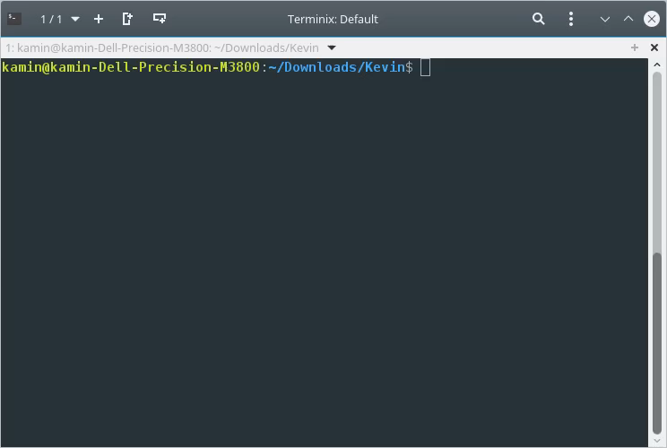
Basic Map Demo
Notes:
Kev Goes, kamin next

Slide 10
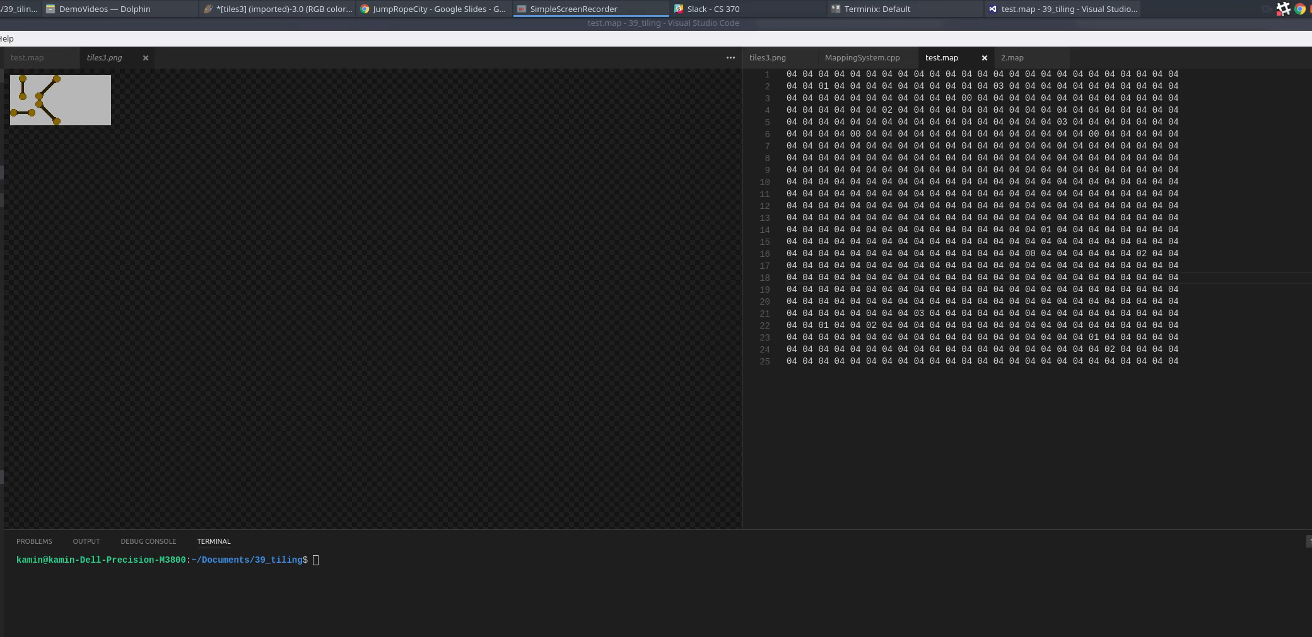
User Generated Mapping
Notes:
Kamin Goes, jay next

Slide 11
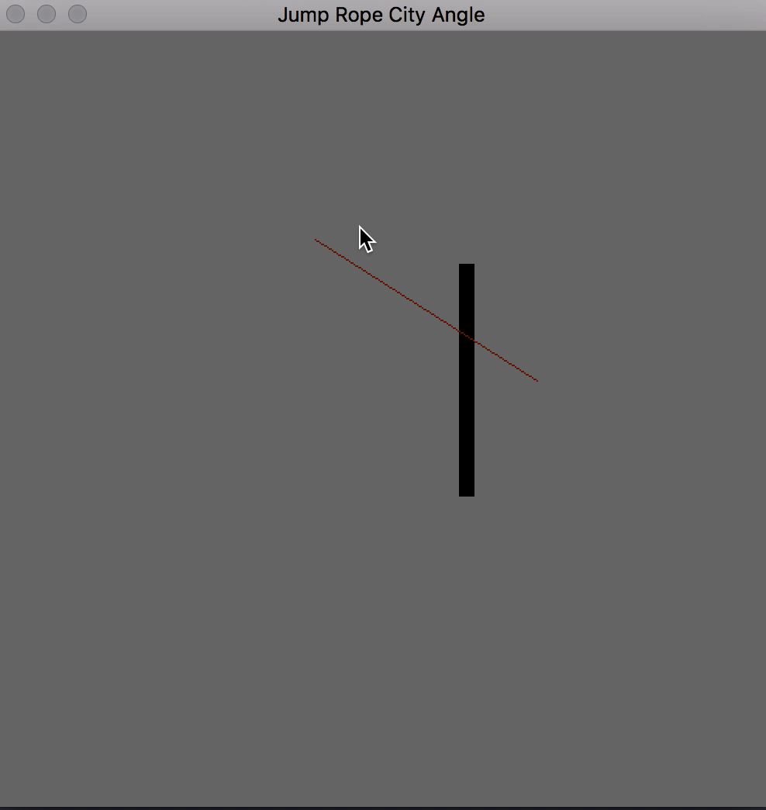
Angling System
Notes:
Jay goes, Ethan next

Slide 12
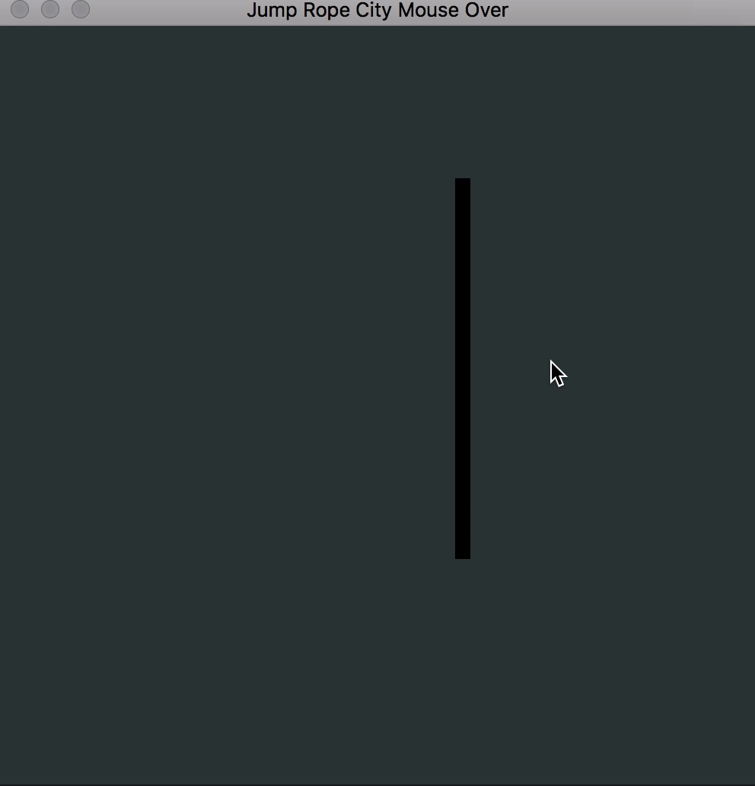
Angling System
Notes:
Jay goes, Ethan next

Slide 13
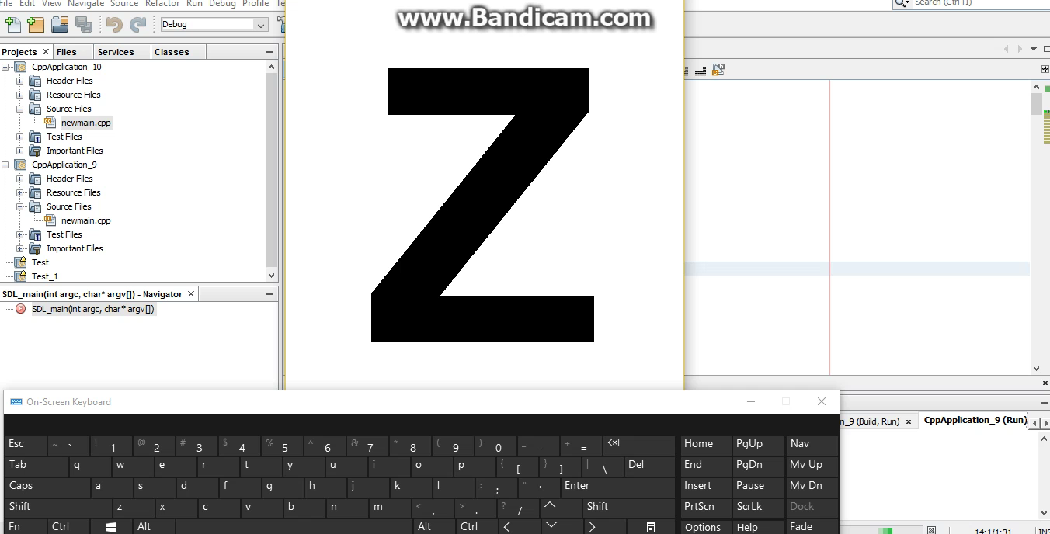
Mouse Key Interaction
Notes:
Ethan Goes, Celine next

Slide 14
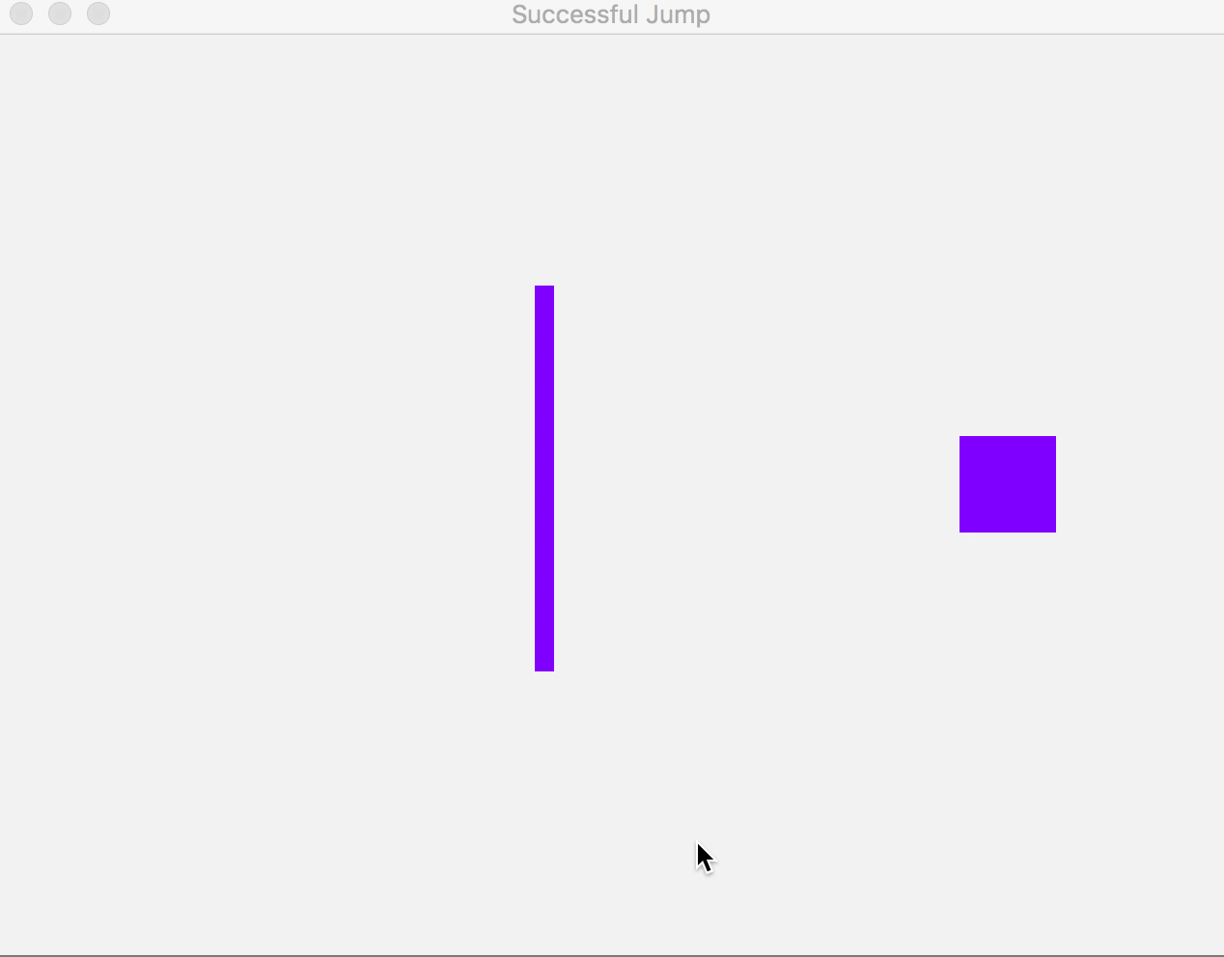
Animation Demo
Notes:
Celine goes, Jay next

Slide 15
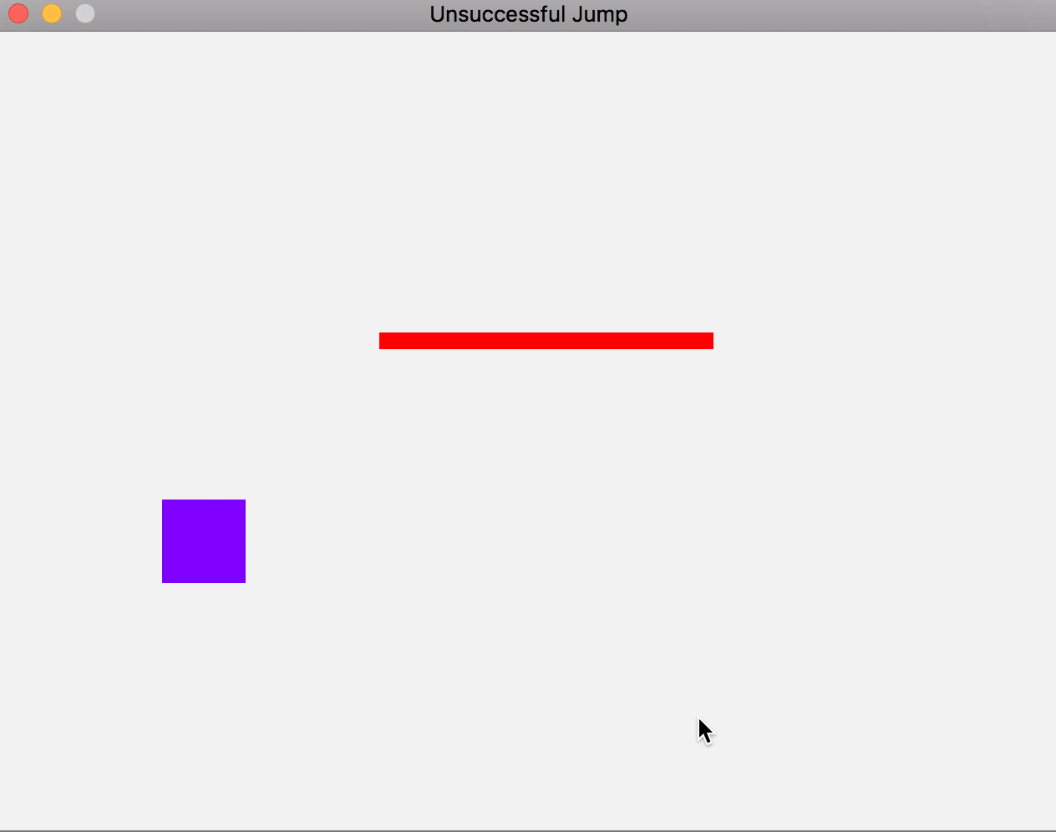
Animation Demo
Notes:
Celine goes, Jay next

Slide 16
Questions? Comments?
Thank You.

